Slide 2



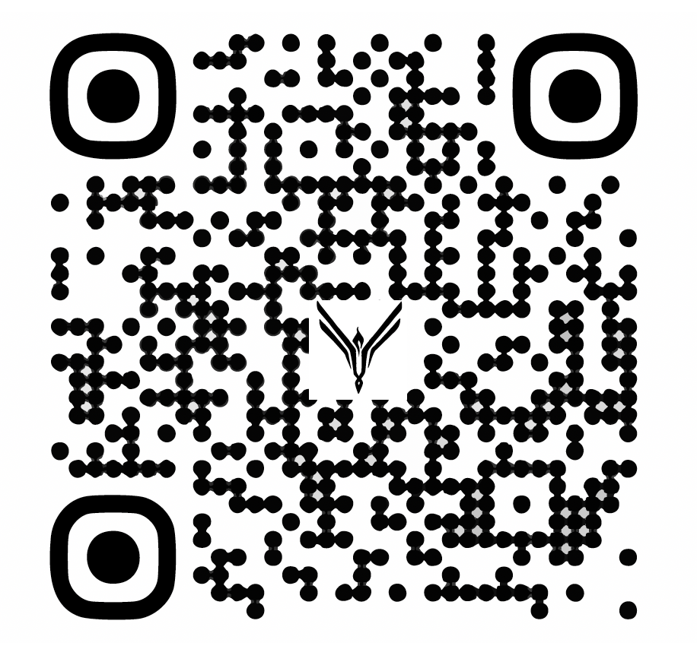
linkedin.com/company/euchtechdk
Notes:
#IMPORTANT EUCTECHDK GUIDELINES SLIDE TO BE PUT IN AS FIRST SLIDE IN YOUR PRESENTATION TO HELP PROMOTE OUR PAGE AT LINKEDIN

Slide 3
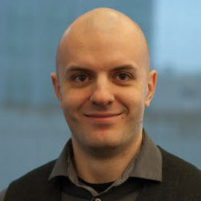
What’s new in AVD and W365:
GPU and Protocol Improvements
Stefan Georgiev
Principal PM – Like-local
linkedin.com/in/st-georgiev/
Notes:
Welcome everyone my name is Stefan Georgiev I am a Principla Procut Manager at Microsoft.
More preciselly I am part of the like-local team. The Like-local team owns the tech that literally takes the remote machine and makes it local aka we own the RDP protocol
Today’s session is about current and future investemets in the RDP protocol we are going to cover (not in the exact order) areas such as transport, graphic/encoder, redirection improvements in RDP.
This session is closely align to a session my team did in Redmond for the MVP summit in March.

Slide 4





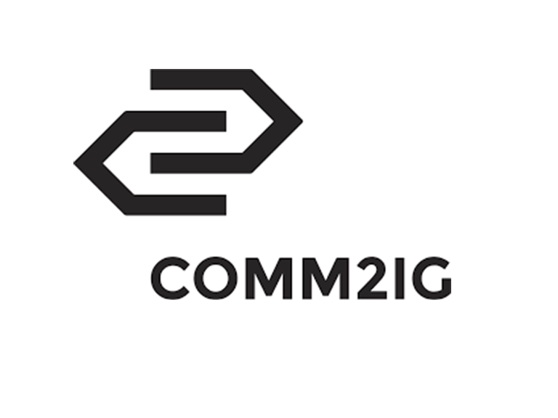

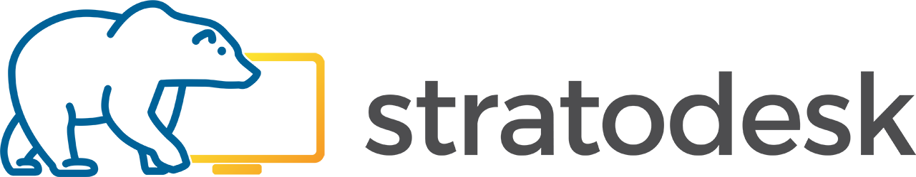
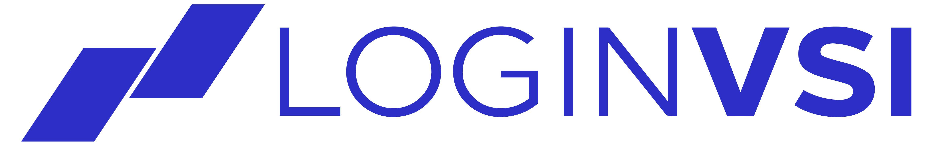








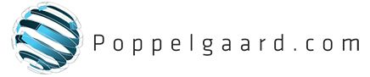
THANK YOU TO OUR SPONSORS
Notes:
Before we move forward I want to acknowledge our sponors. This type of events take time and efort to organize and every organziation on this slide has helped to get us together here today in a very cool place (if I may say) to talk about technologies and spaces we work with daily and we are all passionate about.

Slide 5

Agenda
RDP transport – connection reliability
Connectivity improvements &
simplification
RDP graphics
Connection & sign-in experience
Redirections
New streaming capabilities

Slide 6
Delivering like-local experiences—adapts to user environment
Acceptable
Noticeable degradation in experience, okay for mostly static content, e.g., reading a document
Better
Mostly unnoticeable degradation in experience, okay for most light and medium workloads
Best
Like-local experience
Graphics
throughput
Bandwidth
0.5
1.5
5
15
30
60
Mbps
Min
required
720p @ 30fps
1080p @ 30fps
4K @ 30fps
1080p @ 120fps
4K @ 60fps
2 x 4K @ 60fps
Peripheral latency
E2E latency
175
150
125
100
70
30
Milliseconds
Max
acceptable
Printing
Storage
Keyboard
Mouse
Smartcard
Camera
Inking
All peripherals
CONNECTION SUCCESS ≥ 99.9% | RELIABILITY ≥ 8HOURS MTTF
endpoint requirements minimized to what’s necessary for peripherals
Note: Designed to deliver performance with minimal cloud hardware. Graphics throughput improves with additional hardware.
Notes:
Now, let’s delve into some key aspects of delivering like-local experiences.
Our NorthStar is to deliver an experience that feels like using a local machine, with graphics throughput of two 4K60, and support for all peripherals. This represents the ideal scenario where users experience no noticeable difference between local and remote performance.
However, we recognize that network conditions can vary, and we have designed our solution to gracefully degrade while still providing a usable experience. In the 'Better' scenario, we aim to provide mostly unnoticeable degradation in experience with good interactivity for most medium workloads, offering graphics throughput of 1080p at even 5 Mbps and support for storage, keyboard, and mouse. In the 'Acceptable' scenario, users may notice some degradation in experience, but it remains okay for mostly static content such as reading a document or viewing images, with graphics throughput of 720p and support only for peripherals that need low interaction.
Our service is designed to deliver performance with minimal cloud hardware, and performance, such as graphics throughput, improves with additional hardware. Our goal is always to get as close as possible to like-local performance regardless of network variability. We ensure a connection success rate of over 99.9% and reliability measured by Mean Time To Failure (MTTF) of greater than 8 hours. By minimizing endpoint requirements to what's necessary for peripherals, we can deliver optimal performance under ideal conditions while still providing a usable experience even when network conditions are less favorable.

Slide 7
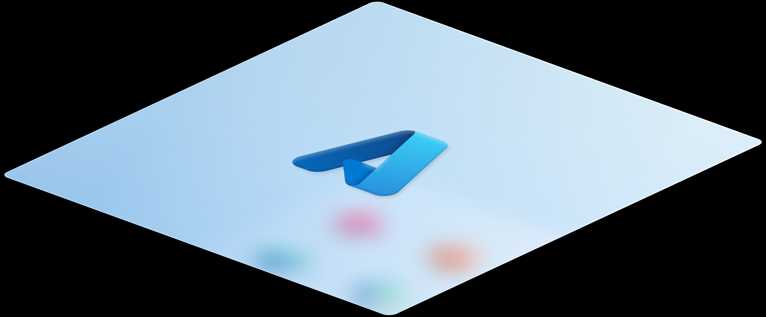
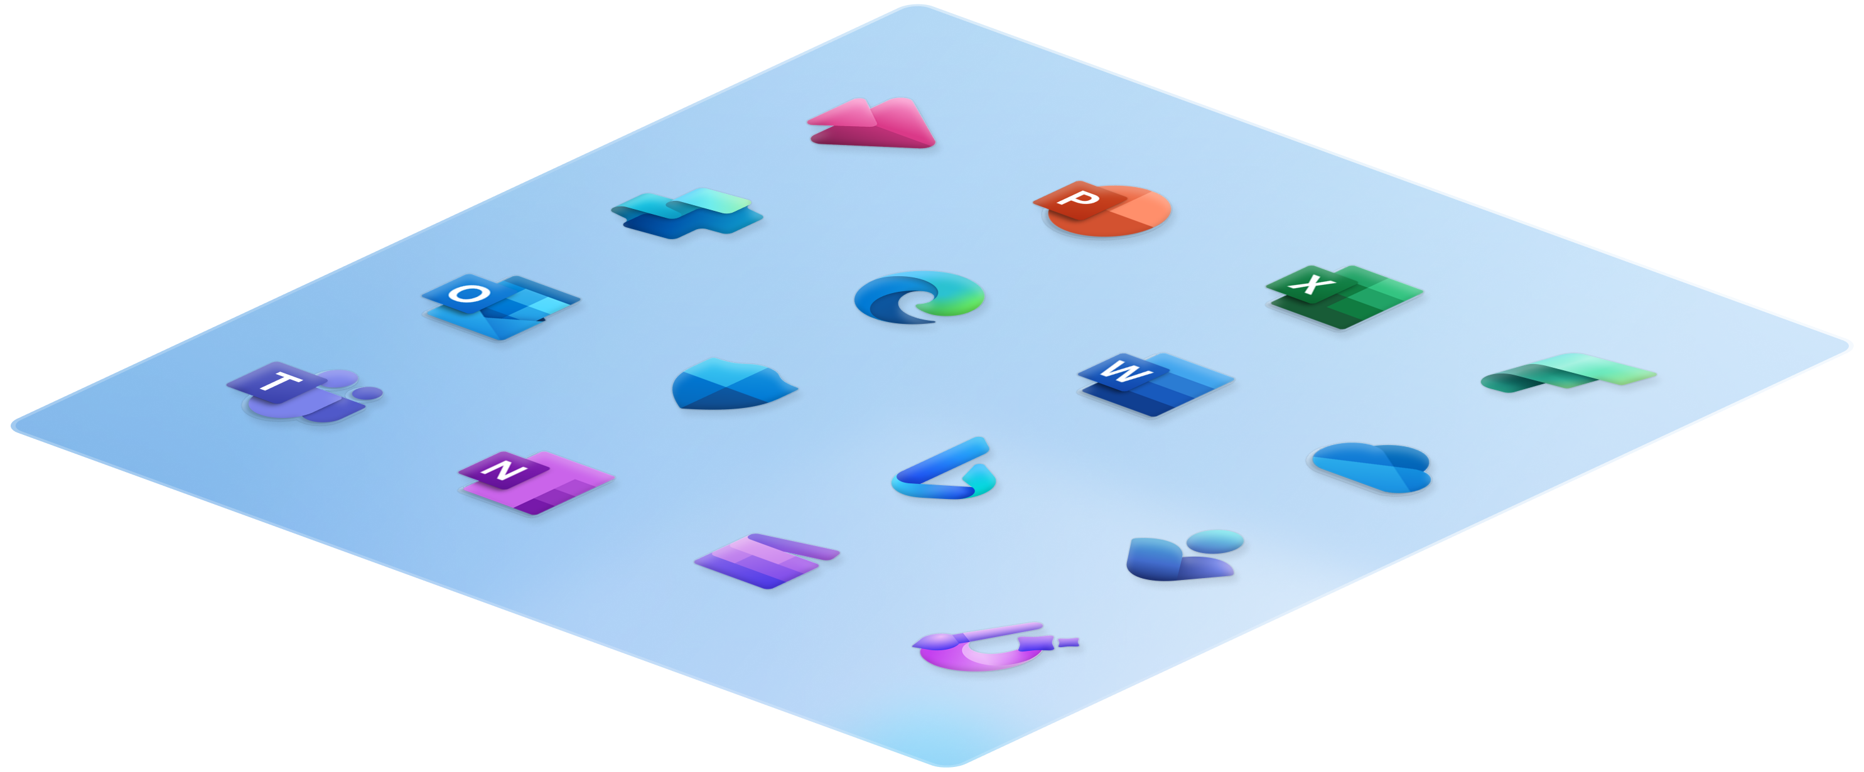

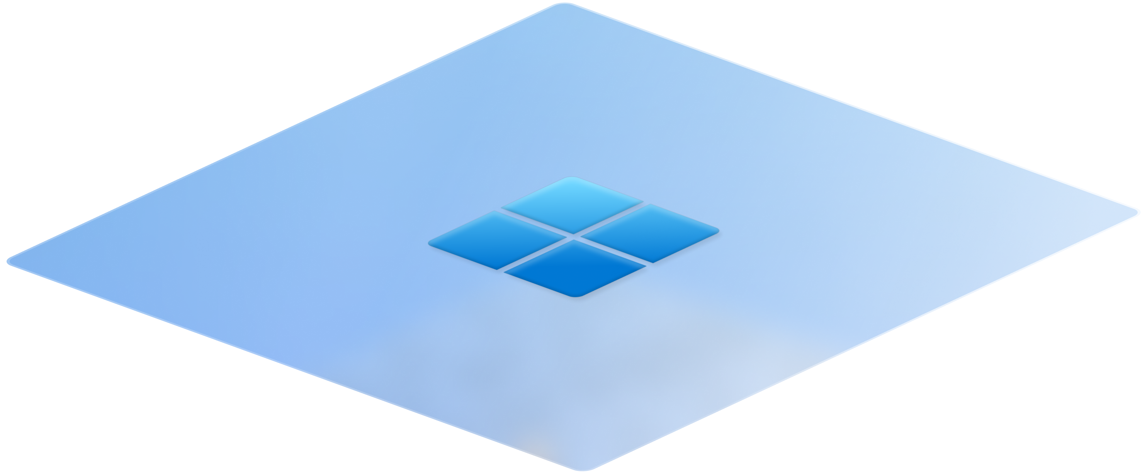
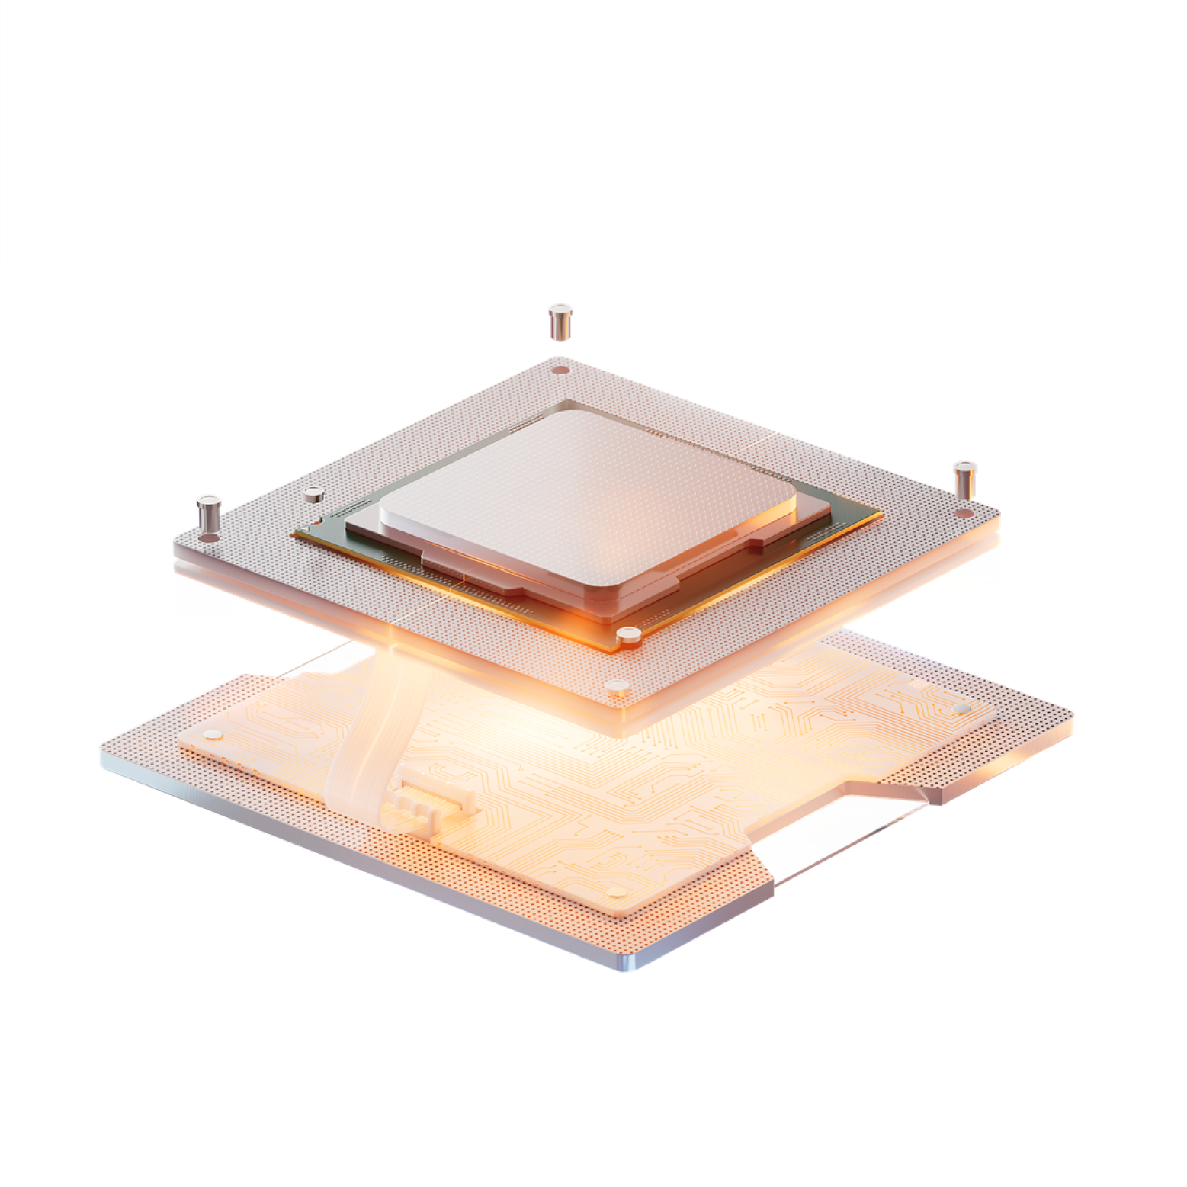

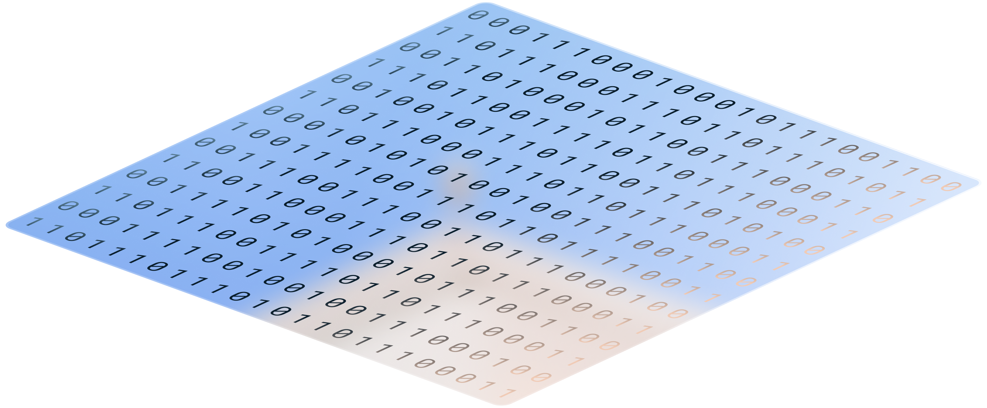
Innovation at every layer
Streaming
Windows cloud solutions
Windows 365 & Azure Virtual Desktop
Windows
Systems
Silicon
Notes:
We are driving innovation at every level of the technology stack - from silicon to the cloud. To deliver like-local Windows from the cloud, it is imperative that we innovate across all layers to stay ahead.
At Microsoft, we are uniquely positioned to drive this innovation due to our comprehensive ownership and expertise across the entire stack. Starting from the foundational layer, silicon, where our strong relationships with leading silicon vendors enable us to push the boundaries of hardware capabilities. Moving up, our systems layer ensures that these hardware advancements are seamlessly integrated and optimized for performance.
Our Windows operating system serves as a robust platform that bridges hardware and software, providing a stable and secure environment for applications to thrive. On top of this foundation lies our Windows cloud solutions - including Windows 365 and Azure Virtual Desktop - which empower businesses with scalable and flexible cloud solutions.
Finally, at the apex of this stack is streaming technology. Our innovations in streaming help ensure that users can access high-quality content seamlessly across devices, enhancing productivity and entertainment experiences alike.
This holistic approach allows us not only to innovate within each layer but also to create synergies between them. By doing so, we deliver unparalleled value and performance to our customers.

Slide 8
RDP transport – connection reliability

Slide 9
Staying connected metric
MTTF (~6 hours)
MTTR (~33 sec)
Correct Behavior
Detect
Repair
Failure
Begin Repair
End Repair
MTTF → Mean time to failure
Time until user noticeable connection disruption.
Single metric doesn’t exist yet, being worked on. Current time calculated from existing data.
MTTR → Mean time to recovery
Time for the system to restore the user’s connection.
Composed of time to detect + time to repair
Notes:
Current threshold is 15 seconds since that's our timeout logic to trigger a full reconnect What gets marked as a ‘failure' today?
Any time the user loses its connection to their VM, such as: goes from WiFI to VPN, and the full connection has to get re-established through VPN.
User's home Internet goes out and must connect back.
Azure WAN flap that cuts off the connection and user must re-establish.

Slide 10
What gets marked as a ‘failure’ today?
Any time the user loses its connection to their VM., e.g., connect from WiFi to VPN, and the full connection must get re-established through VPN.
User’s home Internet goes out and must connect back.
Azure WAN flap that cuts off the connection and user must re-establish.
Notes:
Current threshold is 15 seconds since that's our timeout logic to trigger a full reconnect
Future work can optimize for ‘internal’ or ‘external’ error, and ‘expected’ or ‘unexpected’.

Slide 11
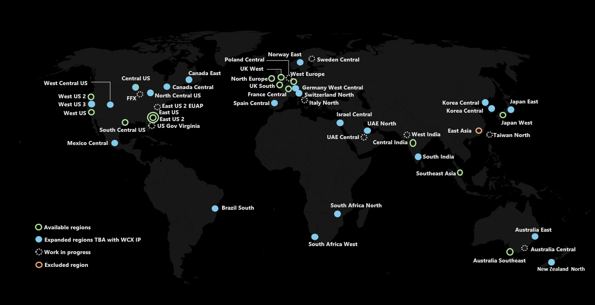
Global TURN relay expansion
Enhancing reliability and optimizing Windows 365 and Azure Virtual Desktop traffic
Notes:
I want to highlight two significant advancements in our network and service strategy: Region expansion and the SFI benefits. Let’s first talk about region expansion. We’re making a major move by increasing the number of regions where our TURN relay is available. Currently, we have 14 regions, but soon, this will expand to 43 regions globally. What does this mean? • With more regions, our dedicated WCX IP can serve users from more geographically diverse locations, which allows us to significantly reduce latency. In short, data has a shorter distance to travel, meaning faster connections and less lag for users. • Enhanced regional coverage also improves overall connection reliability. Users will experience fewer dropped connections and more stable communication sessions, which is especially important for real-time applications relying on reliable UDP connectivity. • Ultimately, what we’re aiming for is a substantial increase in the success rate for reliable UDP transmission. This means that whether users are sending voice, video, or any real-time data, they’ll enjoy smoother, more dependable performance even under varying network conditions. The second key area is the SFI benefits. With this expansion, the dedicated IP range has been tailored specifically for WCX traffic. It’s important to note that this setup is distinct from what we currently have with the ACS TURN relay. What’s the benefit of having a dedicated IP range for WCX traffic? • Firstly, because the IP range is uniquely scoped for Azure Virtual Desktop and Windows 365, it isolates and optimizes traffic flowing through these channels.
• It also creates a scenario where customers can better control and navigate potential limitations imposed by their own network security set-ups. Essentially, by leveraging this dedicated IP, customers have the flexibility to bypass certain network restrictions. This means that the quality and speed of WCX traffic aren’t hindered or filtered by generic security measures designed for broader, non-optimized data. • This dedicated approach underscores our commitment to delivering a highly optimized, reliable, and customer-friendly networking experience, ensuring that the specialized needs of WCX are met without compromise. In summary, the global expansion from 14 to 48 regions will empower us with improved latency and more reliable connections, which directly contributes to a higher success rate in UDP communications. Paired with the dedicated SFI IP range that optimizes WCX traffic handling – and affords our customers the benefit of bypassing less tailored network security restrictions – these initiatives are set to dramatically enhance the performance and user experience across our platform.

Slide 12
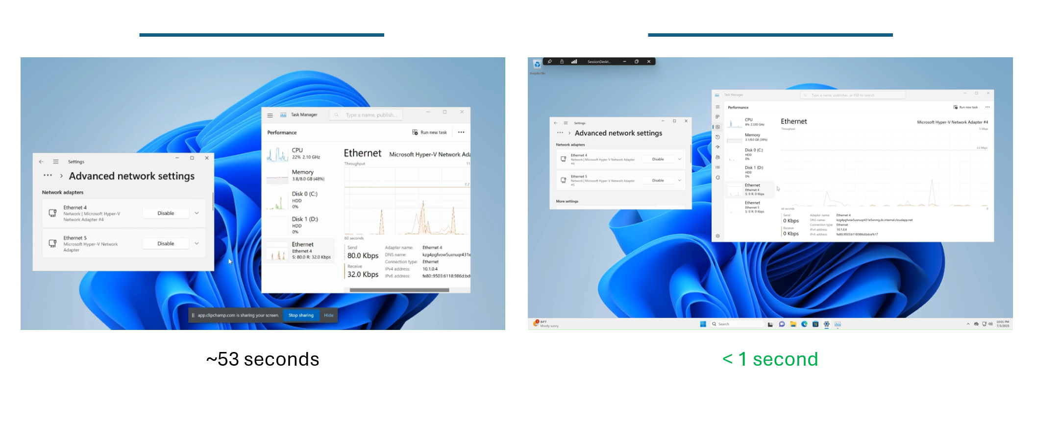
Demo: RDP Multipath
Time to recover when network drops
Notes:
Let's dive into a demo of RDP Multipath, a feature designed to significantly reduce recovery time in the event of a network disconnect.
First and foremost, one of the most compelling aspects of RDP Multipath is that it requires no changes from IT departments or end users. This seamless integration means that everyone can benefit from enhanced connectivity without any additional effort.
RDP Multipath operates by evaluating multiple network paths simultaneously and dynamically switching the active path at runtime behind the scenes. This intelligent path management avoids single points of failure, ensuring that if one path fails, only that specific path is affected while others remain operational.
One of the most impressive benefits is the enhancement in mean time to failure (MTTF), which has been improved by 300%. Previously, MTTF was around 2.5 hours; with RDP Multipath, it extends to 8 hours. This improvement means that most users can now work through their entire day without experiencing any disconnects.
Additionally, we've managed to lower the disconnect rate by 30%, further enhancing user experience and productivity.
To illustrate this point visually:
on the left side of this slide, you see what happens today when there's a network disconnect—a reconnect screen appears and can last for up to a minute. On the right side with RDP Multipath enabled, when we disable an Ethernet port, there is no reconnect screen at all; it just continues working as it switches over to another path within milliseconds. The user does not notice any interruption whatsoever.
In terms of performance metrics: on the left side where traditional methods are used, our P90 (90th percentile) reconnect time is around 53 seconds. On the right side with RDP Multipath enabled, it's less than a second.
This feature represents a significant win for all our end users and customers by providing uninterrupted connectivity and enhancing overall productivity.

Slide 13
IDEA of SMILES
Simple Multiple Independent Links Evaluation and Switching
No change needed to get SMILES.
Evaluate multiple paths at the same time and switch active path at runtime behind the scene.
Avoid single points of failure.
If single point of failure breaks, then only one of the paths is affected.
UDP paths are discovered using ICE.
Supports TCP and UDP paths.

Slide 14
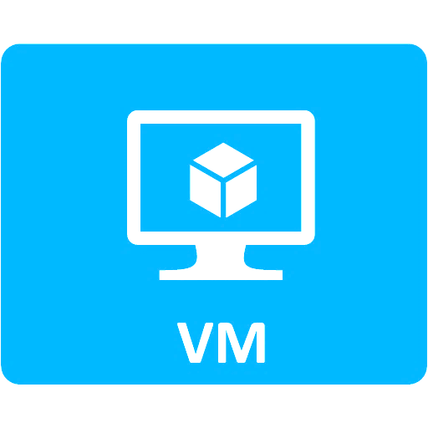

SMILES in action - 1
Active traffic
Relay server
Backup links
UDP
UDP
ISP peering node
UDP
Home router
DC egress point

Slide 15
SMILES in action - 2
Active traffic
Relay server
Backup links
UDP
UDP
ISP peering node
UDP
Home router
DC egress point

Slide 16
SMILES in action - 3
Active traffic
Relay server
Backup links
UDP
UDP
ISP peering node
UDP
Home router
DC egress point
Notes:
We cannot recover 100%, because we cannot avoid all single point of failure.

Slide 17
Rendezvous protocol
Improve connection reliability by providing additional paths through Azure Virtual Desktop gateway
Rendezvous REST API implemented by Azure Virtual Desktop service
Allows server and client to find additional paths through Azure Virtual Desktop gateway
Can be used to improve both MTTF and MTTR

Slide 18
SMILES + Rendezvous in action
Active traffic
Relay server
Backup links
UDP
UDP
UDP
ISP peering node
Home router
DC egress point
TCP
Azure Virtual Desktop Gateway clusters
TCP

Slide 19
SMILES + Rendezvous
Rendezvous REST API URL is provided to client and server during orchestration
Plug in Rendezvous paths into SMILES
Substantially different path compared to ICE paths
Switch between UDP–WebSocket depending on what works best at runtime
Allows SMILES to be usable regardless of UDP availability
Enables quick connection recovery on connection disruption

Slide 20
Connectivity improvements & simplification

Slide 21
Windows 365 & Azure Virtual Desktop: RDP connectivity optimization challenges - 1
# | Problem | Customer impact | Solution | Resulting benefit | ETA
1 | High number of IPs required for RDP bypass/Optimization (~380) | Very hard for customers to bypass/optimize in Zscaler, VPNs etc. due to the large number of entries. Impossible in some cases Easy to misconfigure | Reduced to a single subnet (40.64.144.0/20) | Greatly simplified configuration of optimization Much lower risk of misconfiguration | Delivered Feb 2025
2 | High change rate of endpoint requirements for optimization | Easy to miss changes in requirements High cost to the customer in terms of change management | The new subnet is anticipated to cover our needs for a considerable amount of time | The single subnet removes the need for regular change on the customer side | Delivered Feb 2025
3 | Difficulty configuring bypass in Zscaler | Zscaler is the biggest provider of Secure Web Gateways to WCX customers. We receive constant requests for assistance from customers with Zscaler integration | Zscaler have agreed to create a ‘oneclick’ bypass button for Windows 365/Azure Virtual Desktop. Only the third-ever service they have agreed to do this for | This will vastly simplify bypass configuration and allow for automation of any change in future | Delivered February 2025
4 | Endpoint requirements are listed on static docs pages | Makes it impossible to automate requirement ingestion and easy to miss requirements No automatic update mechanism Easy to miss requirements | Onboarding to Microsoft 365 Endpoint API | Endpoint data accessible from machine readable API which is already integrated into many 3rd party network solutions Simple update method on a known cadence Lowered risk of missing requirements | H1 CY 2025

Slide 22
Windows 365 & Azure Virtual Desktop: RDP connectivity optimization challenges - 2
# | Problem | Customer impact | Solution | Resulting benefit | ETA
5 | TURN relays on non dedicated infrastructure & IP subnet | Difficulty configuring bypass due to non dedicated nature of the range Not available globally | Moving to Windows 365/Azure Virtual Desktop dedicated infrastructure and dedicated single IP range | Simple bypass for all RDP, 1 subnet for TCP and 1 subnet for UDP connectivity, both dedicated to Windows 365/Azure Virtual Desktop Much higher global coverage | April 2025
6 | Windows 365 and Azure Virtual Desktop Docs are unclear on connectivity guidance, scattered in different locations and some essential content in TechCommunity | Great difficulty in understanding the requirements in full Easy to miss guidance and requirements Guidance outside of Docs can be viewed as ‘non-official’ | New Connectivity section in docs to tell the story in a single location Improved, more prescriptive guidance | Simple ‘one-stop’ location for all connectivity guidance Prescriptive guidance removing ambiguity Coverage of all common customer questions to reduce field and WCX workload | Through H1 CY 25
7 | Difficult for customers to diagnose where guidance such as Zscaler bypass, TLS inspection etc is incorrectly configured | Poor connectivity Lengthy troubleshooting High case volume Frequent disconnects Poor user experience | Connectivity tooling to highlight where connectivity does not align to best practice | Easy to check best practice is configured Easy for a customer to isolate where an issue lies and where they need to go to fix the issue Higher performance and service reliability Better user experience | Starting H1 CY25

Slide 23
Connectivity simplification & improvement timeline
TCP RDP IP Consolidation
Updated Docs with optimization guidance
Onboard to Microsoft 365 Endpoint API
Network Connectivity tooling
Reduction of IP subnets from 380 to 1 single subnet
No regular expected changes thereafter
Makes it much simpler to configure bypass/Optimization
Revamped connectivity docs in a cohesive ‘story’ in one location with service specific selection tab available. To be linked with Self-Help in Windows App where possible
Windows 365 & Azure Virtual Desktop endpoints listed in Microsoft 365 endpoint API under new service area
Allows for scripting & automation of access rules
Inbuilt tooling to check for best practice configuration and other network issues to allow customers to isolate issues easily
February 2025
From March 2025
April 2025
H1 CY 2025
H1 CY 2025
H1 CY 2025
Zscaler ‘OneClick’ bypass
TURN Relays on dedicated infrastructure
Other network vendor integration
Single click option for configuring Zscaler to bypass of Windows 365/ Azure Virtual Desktop RDP traffic (TCP and UDP)
Windows 365/Azure Virtual Desktop dedicated TURN relays available with dedicated single subnet
Work with other VPN/network vendors to implement simple bypass options & guidance
Notes:
This slide is a timeline of what we did over the last just H1 of 2025

Slide 24
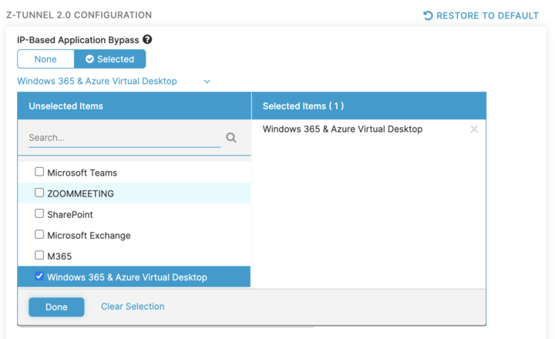
RDP optimization
Traditionally complex due to no support for wildcard FQDN
Needed to bypass 380 regularly changing IPs
High complexity and high risk of error/issues
Now solved!
Move to single subnet 40.64.144.0/20 (Now complete!)
OneClick bypass config within Zscaler portal (Now complete!)
Work with other vendors ongoing
Tooling in Windows App being worked on to check bypass is correctly configured
Notes:
The last 3 slides are full of information and “otimizations” this is what it gets boiled down to and I would like for us to remember – before/traditionally RDP setup was complex now its simpler and we are making it even more simpler

Slide 25
RDP graphics

Slide 26
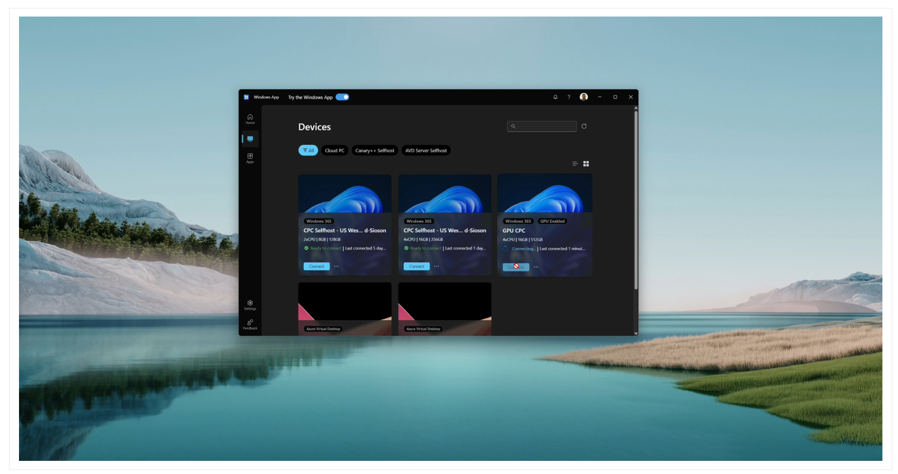
Demo: 4K60 with HEVC/H.265 encode using GPU h/w

Slide 27
Redirections

Slide 28
Peripheral strategy
High-level redirection
Peripheral OEM does additional work to enable performant redirection
Today, DVC integration
The ideal long term future state would leverage WDK, HLK, HDC and WHCP to update the driver for remote awareness
Opaque low-level redirection
Goal
Any peripheral that works with local Windows works in remote
Notes:
To enable this, we need tooling to tell users/IT If devices are correctly configured

Slide 29
Upcoming redirections features
# | Feature | Description | PuP ETA
1 | USB removeable drive redirection AKA no more network drive | Enable USB removeable drives to be recognized in remote Windows as removeable drives rather than network drives. DLP policies assume devices will be removeable not network. | ~25Q2
2 | TWAIN redirection AKA better scanner support | Create a new high-level redirection for enabling any TWAIN device connected to endpoint to redirect into remote session. | 25Q2
3 | DVC libraries | While DVC examples already exist, most OEMs/ISVs do not have experience in COM marshalling with ATL and other coding paradigms. We will release easy to consume libraries that will enable easier DVC creation for OEMs/ISVs for building more performant redirections. | 25Q2

Slide 30
New streaming capabilities

Slide 31
New streaming capabilities
Build shared Azure infrastructure
Create new unified streaming capabilities
Deliver like-local experience
To power our new streaming capabilities, we are using the next generation of GPUs in Azure. In parallel we are driving improvements to the Azure management, allocation and oversubscription capabilities related to these GPUs.
Our new streaming capabilities will offer high graphic throughput (2x 4K 60 FPS) and low end-to-end latencies (<70ms)*. They will combine the best technology from Mixed Reality, Teams (IC3), Windows 365/Azure Virtual Desktop (RPD), and Surface (NXT).
The new capabilities offer low added/encoder latency (<30ms) for a seamless “like-local” experience. They ensure high reliability at 99.9% for consistent 4K60 streaming. They also offer graceful degradation from 2x4K@60FPS to 1080P@60FPS as network conditions downgrade.
Notes:
When talking about direct streaming we can think of our investments as focused in 3 areas. The first one is built new Azure infrastructure including hardware via our partnerships with Nvidia/AMD that Windows 365, Xbox and Inferencing workload can share. Allowing us to drive COGS and COST down. We are also maturing our allocation and oversubscription capabilities, and we have more in the technical overview section.
The second area is where we bring the best technology and expertise from multiple organization to build new streaming platform that over time many different products can adopt.
The third area is showing our user focus approach. Having this shared infrastructure and state of the art streaming platform must bring to the end user an experience that is better and why not even exceed the performance of their local device.

Slide 32
How to use new hardware capabilities
‘Like-local’ experience and power efficient
NPU on client to improve performance
Use client-side models running on NPU
Power efficient denoising
Use GPUs to power encoding server-side
Bandwidth reduction
Can GPU and NPU reduce bandwidth?
Improve RDP on limited network bandwidth
Reducing egress cost

Slide 33
New user profiles
Roaming
In-office
Power/Creator
Teams (4 hours)
Video playback windowed (2)
Video full screen (2)
Static/dynamic pages in Edge (2 hours)
Idle (1)
Email (1)
Video streaming (1 hour)
Productivity (1 hour)
Microsoft Outlook (0.5)
Microsoft Word (0.15)
Microsoft PowerPoint (0.15)
Microsoft Excel (0.15)
OneNote (0.15)
Productivity (4.5 hours)
Microsoft Outlook (3)
Microsoft PowerPoint (0.5)
Microsoft Excel (0.5)
Microsoft Word (0.5)
Teams (1.5 hours)
Meeting windowed (0.75)
Meeting full screen (0.75)
Static/dynamic pages – Edge (1 hour)
Idle (0.5) 0%
Web browsing (0.5)
Video streaming (1 hour)
Productivity (4 hours)
Microsoft PowerPoint (0.5)
Microsoft Excel (0.5)
Microsoft Word (0.5)
Autodesk (1)
Android Studio (1.5)
Teams (1 hours)
Meeting windowed (0.5)
Meeting full screen (0.5)
Static/dynamic pages – Edge (1.5 hours)
Idle (0.75) 0%
Web browsing (0.75)
Video streaming (1.5 hours)
1 x 2K @ 30 FPS
1 x 4K @ 60 FPS
2 x 4K @ 60 FPS
Notes:
In this slide I want to go back to our users. We should not expect that IW run one type of workload. For Horizon 1, we have defined 4 workloads (light, medium, heavy, and power) Session host virtual machine sizing guidelines for Azure Virtual Desktop and Remote Desktop Services | Microsoft Learn. These workloads brings benefits like common language, building a baseline for performance, regression testing and are driving how partners/community/customer measure and define their experience.
We build the three profiles for Horizon 2. One of the goal for these new profiles was to capture the workloads and in session behavior that IW are likely to use in DS and Windows 365. We used few data sources (Windows app telemetry, multiple user studies, and existing Azure Virtual Desktop/Windows 365 data) We then spend time modeling, analyzing and clustering the results. We saw 3 clusters in the data, and we defined a user profile around each of them. e used the app usage telemetry to figure out how much a particular app is being used. Then leveraging Azure Virtual Desktop data we saw the # of screens and resolutions users are clustering around. We took that and applied our target user identity. We used the research done by our UX teams in the IW space to validate the patterns of usage. As we go through the profiles a little bit scenarios, please keep in mind that our goal here is not to match individual users but the overall patterns. Further, we want profiles that allow us to exercise difference scenarios, and we must expect that there is some overlap (e.g., Teams video and video streaming may be equivalent from impact and encoder usage). Obviously, there are assumptions in our analysis. We are updating our assumption and tweaking these profiles as new information is discovered. Down the road, as we get DS closer to production ready, we will come back to and ask for funding to do additional user research and now with product grade DS.
The 3 three profiles are: 1) Roaming, 2) in-office, and 3) Power/Creator. They have different mix of apps and behavior. Each gets a profile card that breaks down in to major
Here is how we should read the profile card. The roaming user type will spend 4 hours in Teams. 2 hours of those will in a meeting where the window is not maximized, and 2 hours will be when it is. Then that user will spend 2 hours in edge. 1 hour actively browsing and 1 hour reading a static content (aka static page). 1 hour will be spend streaming a video and finally 1 hour will be sped in different productivity apps. This is how we should read the other 2 profiles.

Slide 34


Slide 35
a new and unique
Open Source
Benchmark Solution for
User Experience

Slide 36

Obux’s mission
Establish an Open Standard Benchmark for User Experience
Open source, well-documented, non-profit foundation
Super easy to use
Standalone and expandable
Robust and future proof
Community-driven

Slide 37
Shape the product – Work together!
Try Now @ www.obux.it
feedback@obux.it
Participate and / or partner? ruben@obux.it

Slide 38
QA

Slide 39
Thank you

